Slide 1
Chapter 8:
Computer
Reliability

Slide 2
Chapter Overview
Introduction
Data entry or data retrieval errors
Software and billing errors
Notable software system failures
Therac-25
Computer simulations
Software engineering
Software warranties and vendor liability
1-<number>

Slide 3
8.1 Introduction
Computer systems are sometimes unreliable
  Erroneous information in databases
  Misinterpretation of database information
  Malfunction of embedded systems
Effects of computer errors
  Inconvenience
  Bad business decisions
  Fatalities
1-<number>

Slide 4
8.2 Data-Entry or Data-Retrieval
Errors
1-<number>

Slide 5
Two Kinds of Data-related Failure
A computerized system may fail because wrong data entered into it
A computerized system may fail because people incorrectly interpret data they retrieve
1-<number>

Slide 6
Disfranchised Voters
November 2000 general election
Florida disqualified thousands of voters
Reason: People identified as felons
Cause: Incorrect records in voter database
Consequence: May have affected election’s outcome
1-<number>

Slide 7
False Arrests
Sheila Jackson Stossier mistaken for Shirley Jackson
  Arrested and spent five days in detention
Roberto Hernandez mistaken for another Roberto Hernandez
  Arrested twice and spent 12 days in jail
Terry Dean Rogan arrested after someone stole his identity
  Arrested five times, three times at gun point
1-<number>

Slide 8
Accuracy of NCIC Records
March 2003: Justice Dept. announces FBI not responsible for accuracy of NCIC information
Exempts NCIC from some provisions of Privacy Act of 1974
Should government take responsibility for data correctness?
1-<number>

Slide 9
Dept. of Justice Position
Impractical for FBI to be responsible for data’s accuracy
Much information provided by other law enforcement and intelligence agencies
Agents should be able to use discretion
If provisions of Privacy Act strictly followed, much less information would be in NCIC
Result: fewer arrests
1-<number>

Slide 10
Position of Privacy Advocates
Number of records is increasing
More erroneous records → more false arrests
Accuracy of NCIC records more important than ever
1-<number>

Slide 11
Act Utilitarian Analysis:
Database of Stolen Vehicles
Over 1 million cars stolen every year
Just over half are recovered, say 500,000
Assume NCIC is responsible for at least 20%
100,000 cars recovered because of NCIC
Benefit of $5,000 per car (owner gets car back; effects on national insurance rates; criminal doesn’t profit)
Total value of NCIC stolen vehicle database: $500,000/year
Only a few stories of false arrests
Assume 1 false arrest per year (probably high)
Assume harm caused by false arrest $55,000 (size of award to Rogan)
Benefit surpasses harm by $445,000/year
Conclusion: Good to have NCIC stolen vehicles database
1-<number>

Slide 12
8.3 Software and Billing Errors
1-<number>

Slide 13
Errors When Data Are Correct
Assume data correctly fed into computerized system
System may still fail if there is an error in its programming
1-<number>

Slide 14
Errors Leading to System Malfunctions
Qwest sent incorrect bills to cell phone customers
Faulty USDA beef price reports
U.S. Postal Service returned mail addressed to Patent and Trademark Office
Spelling and grammar error checkers increased errors
New York City Housing authority overcharged renters
About 450 California prison inmates mistakenly released
1-<number>

Slide 15
Errors Leading to System Failures
Ambulance dispatch system in London
Chicago Board of Trade
BMW limousine
Japan’s air traffic control system
Los Angeles County + USC Medical Center laboratory computer system
Comair’s Christmas Day shutdown
Boeing 777
1-<number>

Slide 16
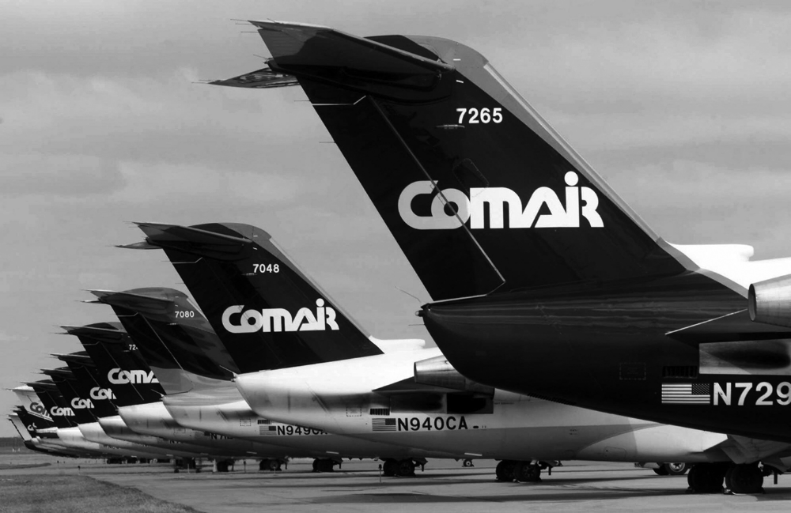
Comair Cancelled All Flights on Christmas Day, 2004
AP Photo/Al Behrman, File
1-<number>

Slide 17
Analysis: E-Retailer Posts Wrong Price, Refuses to Deliver
Amazon.com in Britain offered iPaq for £7 instead of £275
Orders flooded in
Amazon.com shut down site, refused to deliver unless customers paid true price
Was Amazon.com wrong to refuse to fill the orders?
1-<number>

Slide 18
Rule Utilitarian Analysis
Imagine rule: A company must always honor the advertised price
Consequences
  More time spent proofreading advertisements
  Companies would take out insurance policies
  Higher costs → higher prices
  All consumers would pay higher prices
  Few customers would benefit from errors
Conclusion
  Rule has more harms than benefits
  Amazon.com did the right thing
1-<number>

Slide 19
Kantian Analysis
Buyers knew 97.5% markdown was an error
They attempted to take advantage of Amazon.com’s stockholders
They were not acting in “good faith”
Buyers were in the wrong, not Amazon.com
1-<number>

Slide 20
8.4 Notable Software System Failures
1-<number>

Slide 21
Patriot Missile
Designed as anti-aircraft missile
Used in 1991 Gulf War to intercept Scud missiles
One battery failed to shoot at Scud that killed 28 soldiers
Designed to operate only a few hours at a time
Kept in operation > 100 hours
Tiny truncation errors added up
Clock error of 0.3433 seconds → tracking error of 687 meters
1-<number>

Slide 22
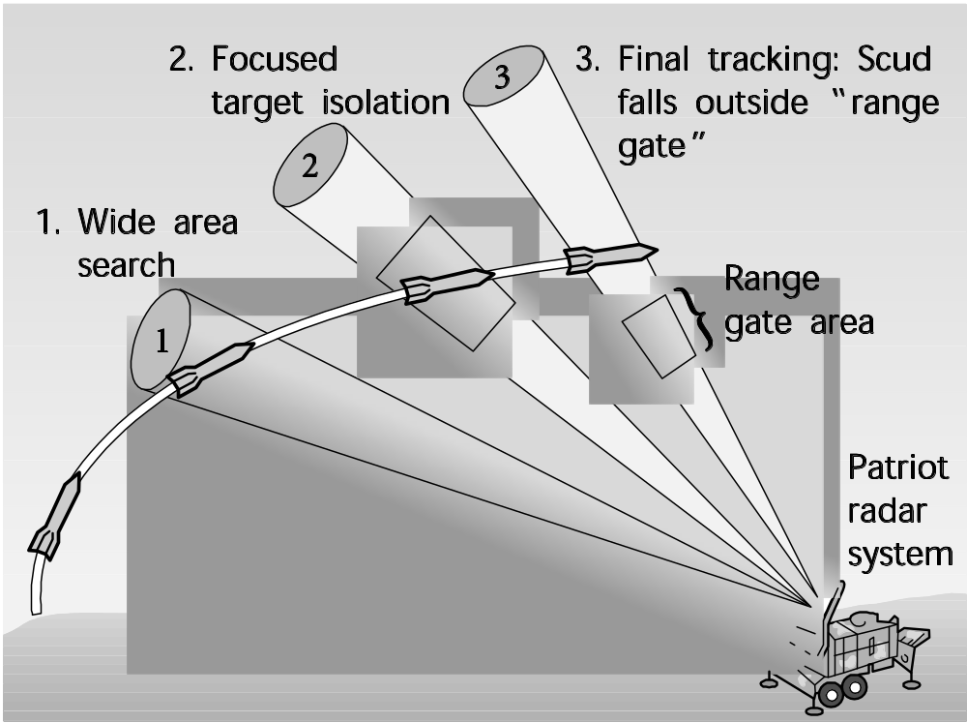
Patriot Missile Failure
Figure from SCIENCE 255:1347. Copyright ©1992 by The American Association for the Advancement of Science. Reprinted with permission.
1-<number>

Slide 23
Ariane 5
Satellite launch vehicle
40 seconds into maiden flight, rocket self-destructed
  $500 million of uninsured satellites lost
Statement assigning floating-point value to integer raised exception
Exception not caught and computer crashed
Code reused from Ariane 4
  Slower rocket
  Smaller values being manipulated
  Exception was impossible
1-<number>

Slide 24
AT&T Long-Distance Network
Significant service disruption
  About half of telephone-routing switches crashed
  70 million calls not put through
  60,000 people lost all service
  AT&T lost revenue and credibility
Cause
  Single line of code in error-recovery procedure
  Most switches running same software
  Crashes propagated through switching network
1-<number>

Slide 25
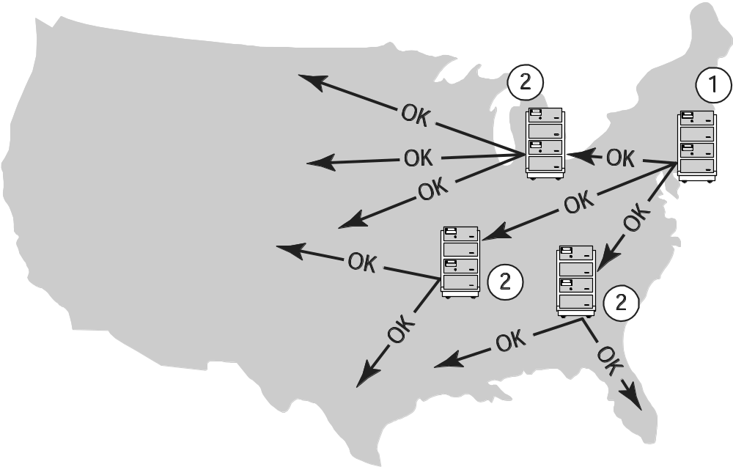
AT&T Long Distance Network Failure
1-<number>

Slide 26
Robot Missions to Mars
Mars Climate Orbiter
  Disintegrated in Martian atmosphere
  Lockheed Martin design used English units
  Jet Propulsion Lab design used metric units
Mars Polar Lander
  Crashed into Martian surface
  Engines shut off too soon
  False signal from landing gear
1-<number>

Slide 27
Denver International Airport
BAE built automated baggage handling system
Problems
  Airport designed before automated system chosen
  Timeline too short
  System complexity exceeded development team’s ability
Results
  Added conventional baggage system
  16-month delay in opening airport
  Cost Denver $1 million a day
1-<number>

Slide 28
Tokyo Stock Exchange
First day of trading for J-Com
Mizuho Securities employee mistakenly enters order to sell 610,00 shares at 1 yen, instead of 1 share at 610,000 yen
Employee overrides computer warning
After sell order posted on exchange’s display board, Mizuho tries to cancel order several times; software bug causes attempts to fail
Mizuho loses $225 million buying back shares
1-<number>

Slide 29
Direct Recording Electronic Voting Machines
After problems with 2000 election, Congress passed Help America Vote Act of 2002
HAVA provided money to states to replace punch card voting systems
Many states used HAVA funds to purchase direct recording electronic (DRE) voting machines
Brazil and India have run national elections using DRE voting machines exclusively
In November 2006 1/3 of U.S. voters used DRE voting machines
1-<number>

Slide 30
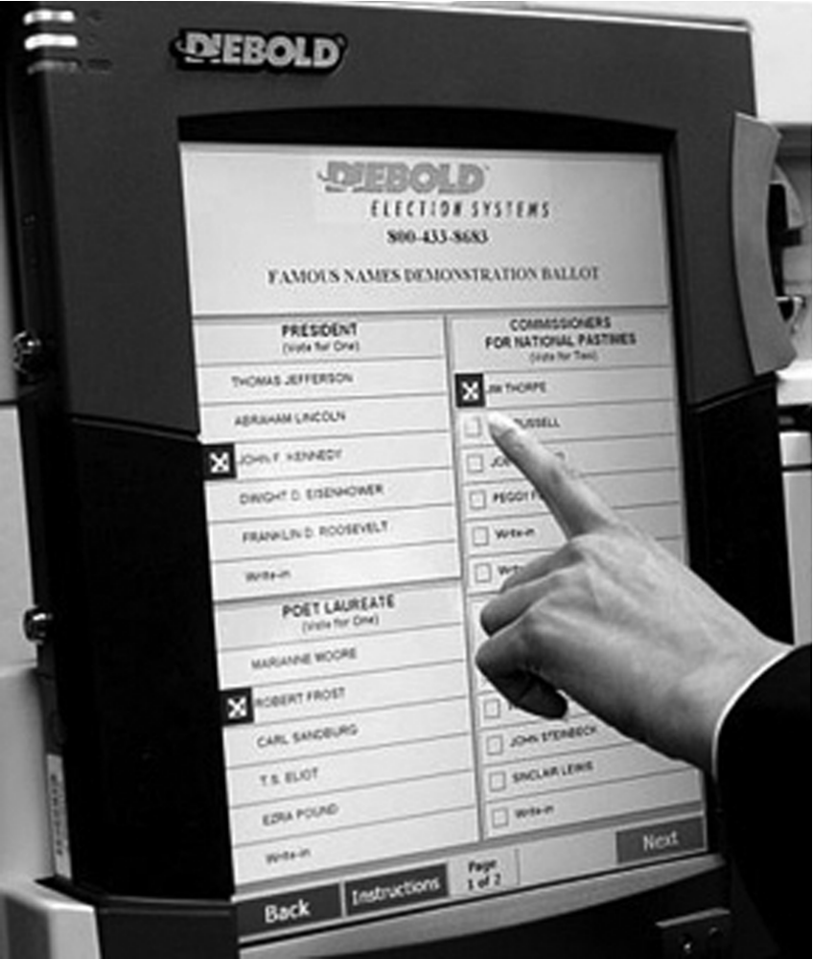
Diebold Electronic Voting Machine
© AP Photo/Rogelio Solis
1-<number>

Slide 31
Issues with DRE Voting Machines
Voting irregularities
  Failure to record votes
  Overcounting votes
  Misrecording votes
Lack of a paper audit trail
Vulnerability to tampering
Source code a trade secret, can’t be examined
Possibility of widespread fraud through malicious programming
1-<number>

Slide 32
8.5 Therac-25
1-<number>

Slide 33
Genesis of the Therac-25
AECL and CGR built Therac-6 and Therac-20
Therac-25 built by AECL
  PDP-11 an integral part of system
  Hardware safety features replaced with software
  Reused code from Therac-6 and Therac-20
First Therac-25 shipped in 1983
  Patient in one room
  Technician in adjoining room
1-<number>

Slide 34
Chronology of Accidents and AECL Responses
Marietta, Georgia (June 1985)
Hamilton, Ontario (July 1985)
First AECL investigation (July-Sept. 1985)
Yakima, Washington (December 1985)
Tyler, Texas (March 1986)
Second AECL investigation (March 1986)
Tyler, Texas (April 1986)
Yakima, Washington (January 1987)
FDA declares Therac-25 defective (February 1987)
1-<number>

Slide 35
Software Errors
Race condition: order in which two or more concurrent tasks access a shared variable can affect program’s behavior
Two race conditions in Therac-25 software
  Command screen editing
  Movement of electron beam gun
1-<number>

Slide 36
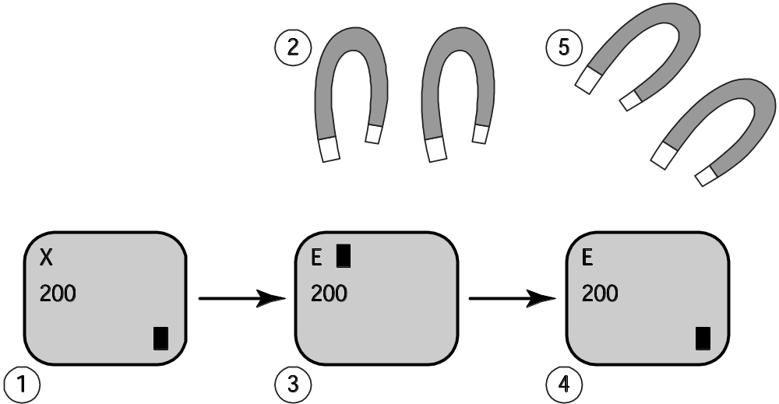
Race Condition Revealed by Fast-typing Operators
1-<number>

Slide 37
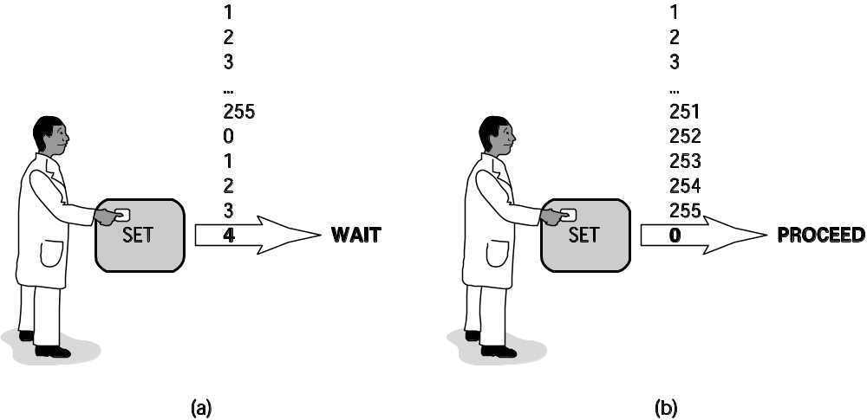
Race Condition Caused by Counter Rolling Over to Zero
1-<number>

Slide 38
Post Mortem
AECL focused on fixing individual bugs
System not designed to be fail-safe
No devices to report overdoses
Software lessons
  Difficult to debug programs with concurrent tasks
  Design must be as simple as possible
  Documentation crucial
  Code reuse does not always lead to higher quality
AECL did not communicate fully with customers
1-<number>

Slide 39
Moral Responsibility of the
Therac-25 Team
Conditions for moral responsibility
  Causal condition: actions (or inactions) caused the harm
  Mental condition
    Actions (or inactions) intended or willed -OR-
    Moral agent is careless, reckless, or negligent
Therac-25 team morally responsible
  They constructed the device that caused the harm
  They were negligent
1-<number>

Slide 40
Postscript
Computer errors related to radiation machines continue to maim and kill patients
Investigation by The New York Times
  Scott Jerome-Parks, New York (2006)
  Alexandra Jn-Charles, New York (2006)
1-<number>

Slide 41
8.6 Computer Simulations
1-<number>

Slide 42
Uses of Simulations
Simulations replace physical experiments
  Experiment too expensive or time-consuming
  Experiment unethical
  Experiment impossible
Model past events
Understand world around us
Predict the future
1-<number>

Slide 43
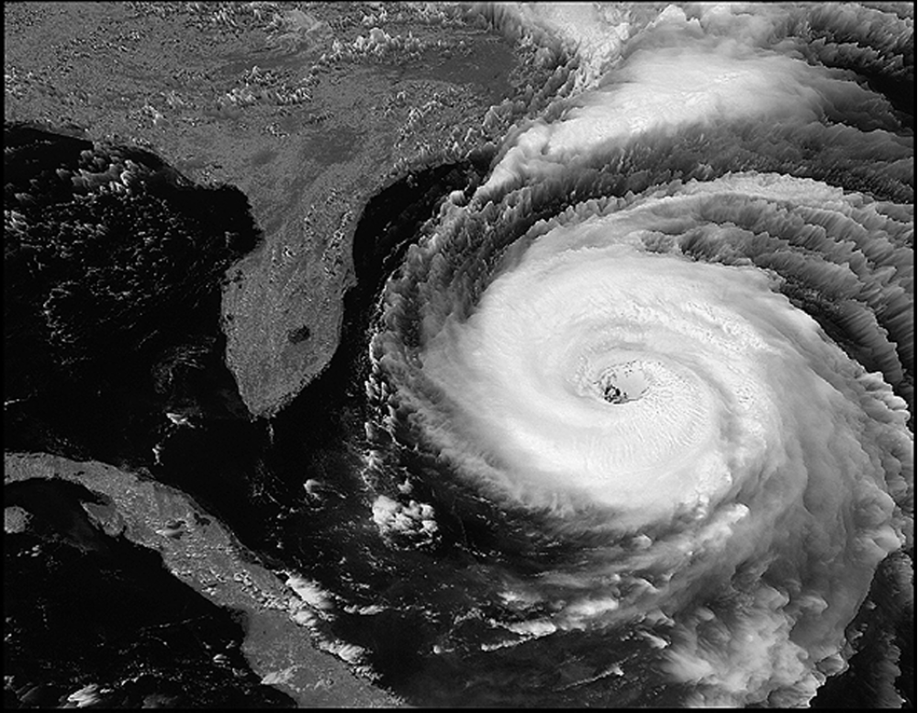
Simulations Predict Path and Speed of Hurricanes
Courtesy of NASA
1-<number>

Slide 44
Validating Simulations
Verification: Does program correctly implement model?
Validation: Does the model accurately represent the real system?
Validation methods
  Make prediction, wait to see if it comes true
  Predict the present from old data
  Test credibility with experts and decision makers
1-<number>

Slide 45
Validating a Model
<insert Figure 8.8>
1-<number>

Slide 46
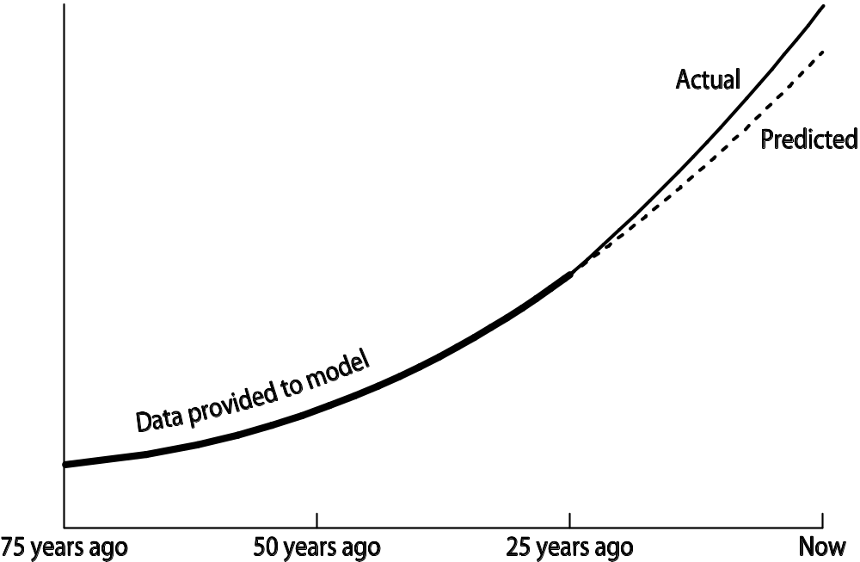
Validation by “Predicting the Present”
1-<number>

Slide 47
8.7 Software Engineering
1-<number>

Slide 48
Specification
Determine system requirements
Understand constraints
Determine feasibility
End products
  High-level statement of requirements
  Mock-up of user interface
  Low-level requirements statement
1-<number>

Slide 49
Development
Create high-level design
Discover and resolve mistakes, omissions in specification
CASE tools to support design process
Object-oriented systems have advantages
After detailed design, actual programs written
Result: working software system
1-<number>

Slide 50
Validation (Testing)
Ensure software satisfies specification
Ensure software meets user’s needs
Challenges to testing software
  Noncontinuous responses to changes in input
  Exhaustive testing impossible
  Testing reveals bugs, but cannot prove none exist
Test modules, then subsystems, then system
1-<number>

Slide 51
Software Quality Is Improving
Standish Group tracks IT projects
Situation in 1994
  1/3 projects cancelled before completion
  1/2 projects had time and/or cost overruns
  1/6 projects completed on time and on budget
Situation in 2009
  1/4 projects cancelled
  5/12 projects had time and/or cost overruns
  1/3 projects completed on time and on budget
1-<number>

Slide 52
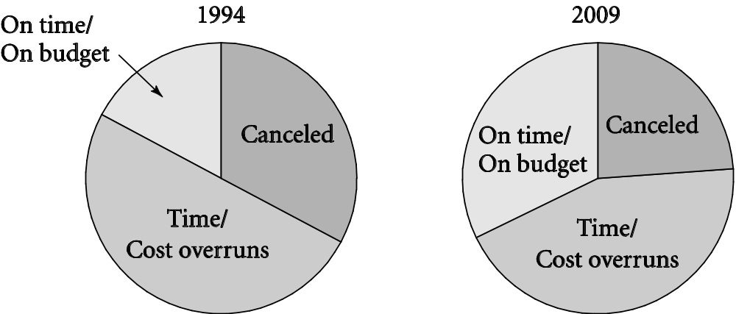
Success of IT Projects Over Time
1-<number>

Slide 53
8.8 Software Warranties and
Vendor Liability
1-<number>

Slide 54
Shrinkwrap Warranties
Some say you accept software “as is”
Some offer 90-day replacement or money-back guarantee
None accept liability for harm caused by use of software
1-<number>

Slide 55
Are Software Warranties Enforceable?
Mass-marketed software and software included in sale of hardware likely to be considered a good by a court of law
Uniform Commercial Code applies to goods, despite what warranties may say
1-<number>

Slide 56
Key Court Cases
Step-Saver Data Systems v. Wyse Technology and the Software Link
  Court ruled that provisions of UCC held
ProCD v. Zeidenberg
  Court ruled shrinkwrap licenses are enforceable
Mortenson v. Timberline Software
  Court ruled in favor of Timberline and licensing agreement that limited consequential damages
1-<number>

Slide 57
Moral Responsibility of Software Manufacturers
If vendors were responsible for harmful consequences of defects
  Companies would test software more
  They would have to purchase liability insurance
  Software would cost more
  Start-ups would be affected more than big companies
  Less innovation in software industry?
  Software would be more reliable?
Making vendors responsible for harmful consequences of defects may be a bad idea, but…
Consumers should not have to pay for bug fixes
1-<number>

